Slide 1

Generating of intermediate code for a new language using lex
-submitted by
N.DIVYA SRI (192211139)
POOJA SRI V (192210152)
AISHWARYA (192124037)

Slide 2
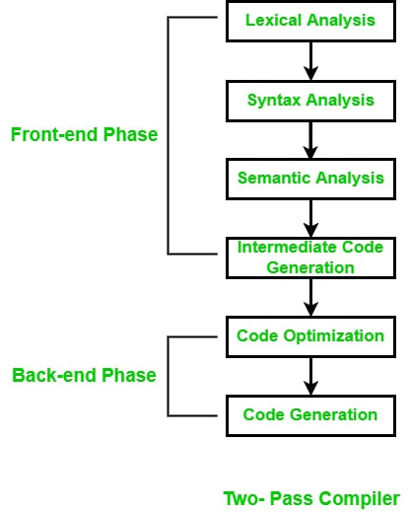
Generating of intermediate code
The final phase of the compiler front-end.
GOAL: translate program into a format expected by the compiler back-end.
IN TYPICAL COMPILERS: followed by intermediate code optimization and machine code generation.

Slide 3
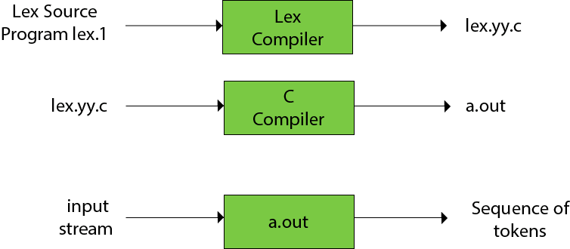
About lex
LEX is a tool that allows one to specify a lexical Analyzer by specifying RE to describe patterns for tokens.
Input notation-lex language(specification)
Lex compiler-transforms input patterns into a transition diagram and generate code in a file called lex.yy.c

Slide 4
Problem Statement
Language Definition: Define the syntax, semantics, and lexical structure of the new programming language. Specify the language's keywords, operators, data types, control structures, and other language constructs.
Lexical Analysis: Utilise Lex to perform lexical analysis on the input source code of the new language. Develop lexical rules using regular expressions to tokenize the source code into meaningful units, such as identifiers, literals, and operators.

Slide 5
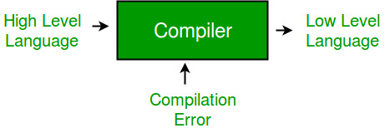
Proposed Design
Requirements Gathering and Analysis: Identify stakeholders involved in the development and use of the new language compiler, including language designers, developers, testers, and end-user.
Tool Selection Criteria: Ensure compatibility with Lex or Flex, as Lex is the chosen tool for lexical analysis in the project.
Scanning and Testing Methodology:
Inspect the generated lexical analyser code to identify potential issues or ambiguities in token recognition.

Slide 6
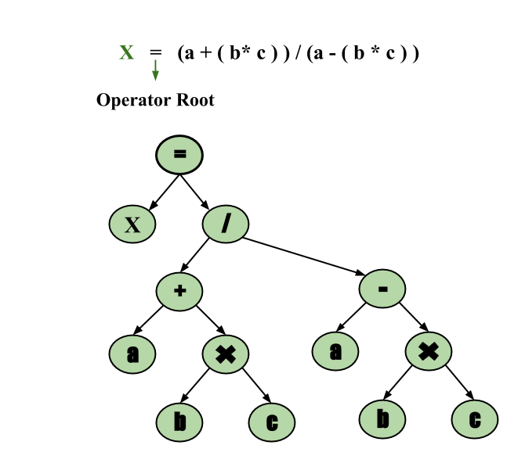
Postfix Notation:Example 1: The postfix representation of the expression (a + b) * c is : ab + c * Example 2: The postfix representation of the expression (a – b) * (c + d) + (a – b) is : ab – cd + *ab -+
Three-Address Code: A three address statement involves a maximum of three references, consisting of two for operands and one for the result.
Example: The three address code for the expression a + b * c + d : T1 = b * c T2 = a + T1 T3 = T2 + d; T 1 , T2 , T3 are temporary variables.
Syntax Tree: The syntax tree not only condenses the parse tree but also offers an improved visual representation of the program’s syntactic structure, Example: x = (a + b * c) / (a – b * c)

Slide 7
Conclusion
Finally, In summary, generating intermediate code for a new language using the Lex project offers a robust solution for lexical analysis and code generation.
By leveraging the capabilities of Lex and incorporating best practices in development workflows, developers can efficiently create, analyse, and optimise intermediate representations, laying.
a solid foundation for the implementation of diverse language features and applications.

Slide 8

Thank You!

